Slide 1
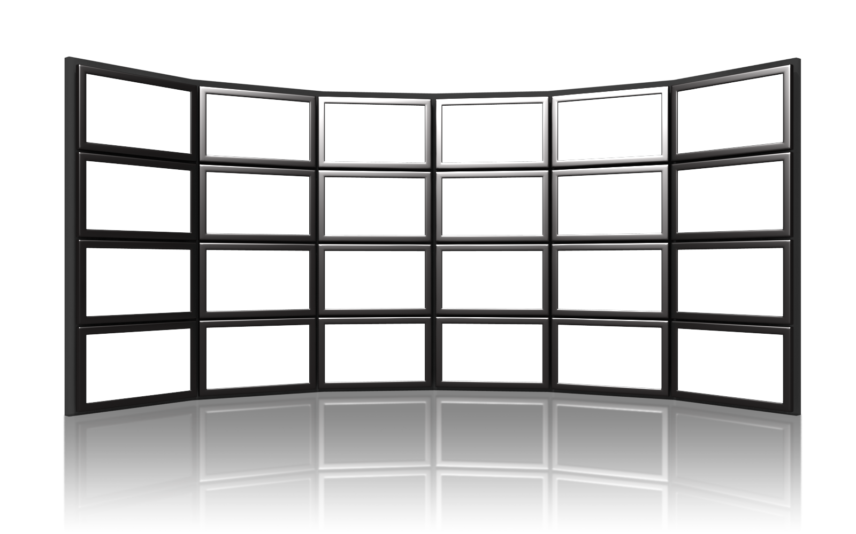
VIDEOWALL TOOL KIT
Change this picture, make sure it is sent to the back, and apply a motion path animation to it.
Left To Right

Slide 2
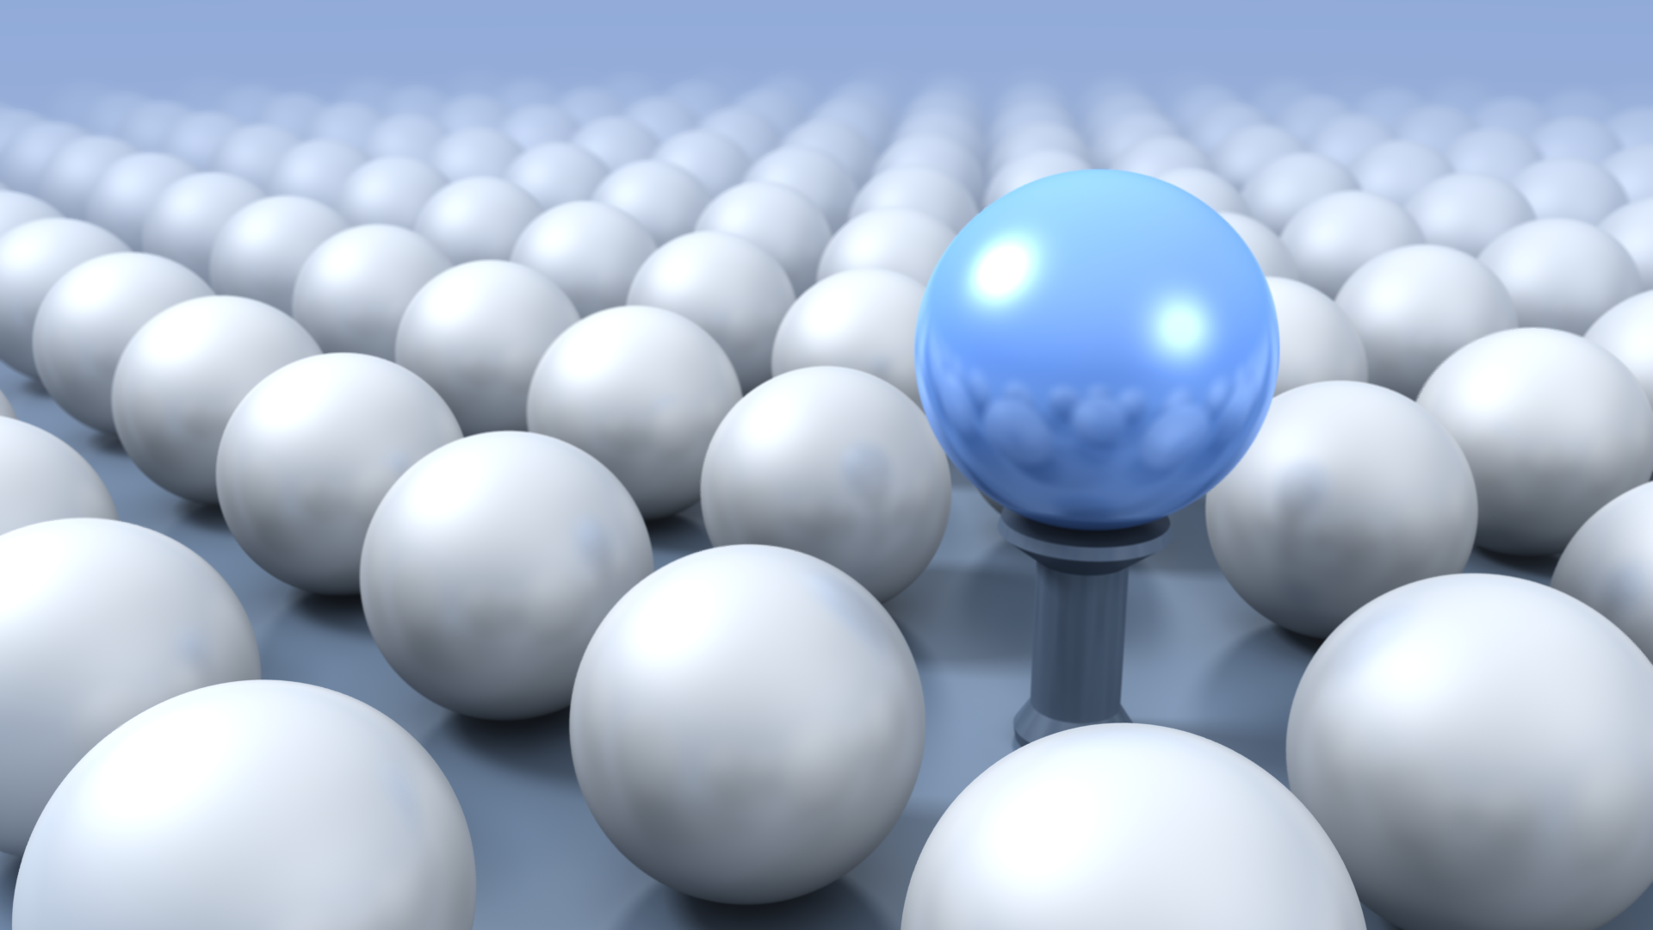
VIDEOWALL TOOL KIT
Change this picture, make sure it is sent to the back, and apply a motion path animation to it.
Right To Left

Slide 3
VIDEOWALL TOOL KIT
Change this picture, make sure it is sent to the back, and apply a motion path animation to it.
Top To Bottom

Slide 4
VIDEOWALL TOOL KIT
Change this picture, make sure it is sent to the back, and apply a motion path animation to it.
Bottom To Top

Slide 6
Tips for Success
Use Large Pictures
Send the Picture to the Background
Apply a Motion Path PowerPoint animation to move the pictures
Control the duration in Effect Options of the Animation Pane

